Slide 1
Data conversion – binary to text format (FL30)
Work through example on
https://renkulab.io/p/eric.pohl/discharge-calculation-dilution-method
In RStudio on renkulab.io (same workflow on your own computer)

Slide 2
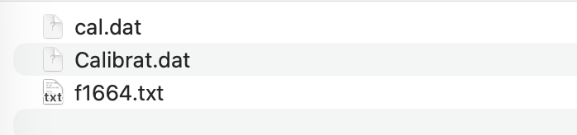
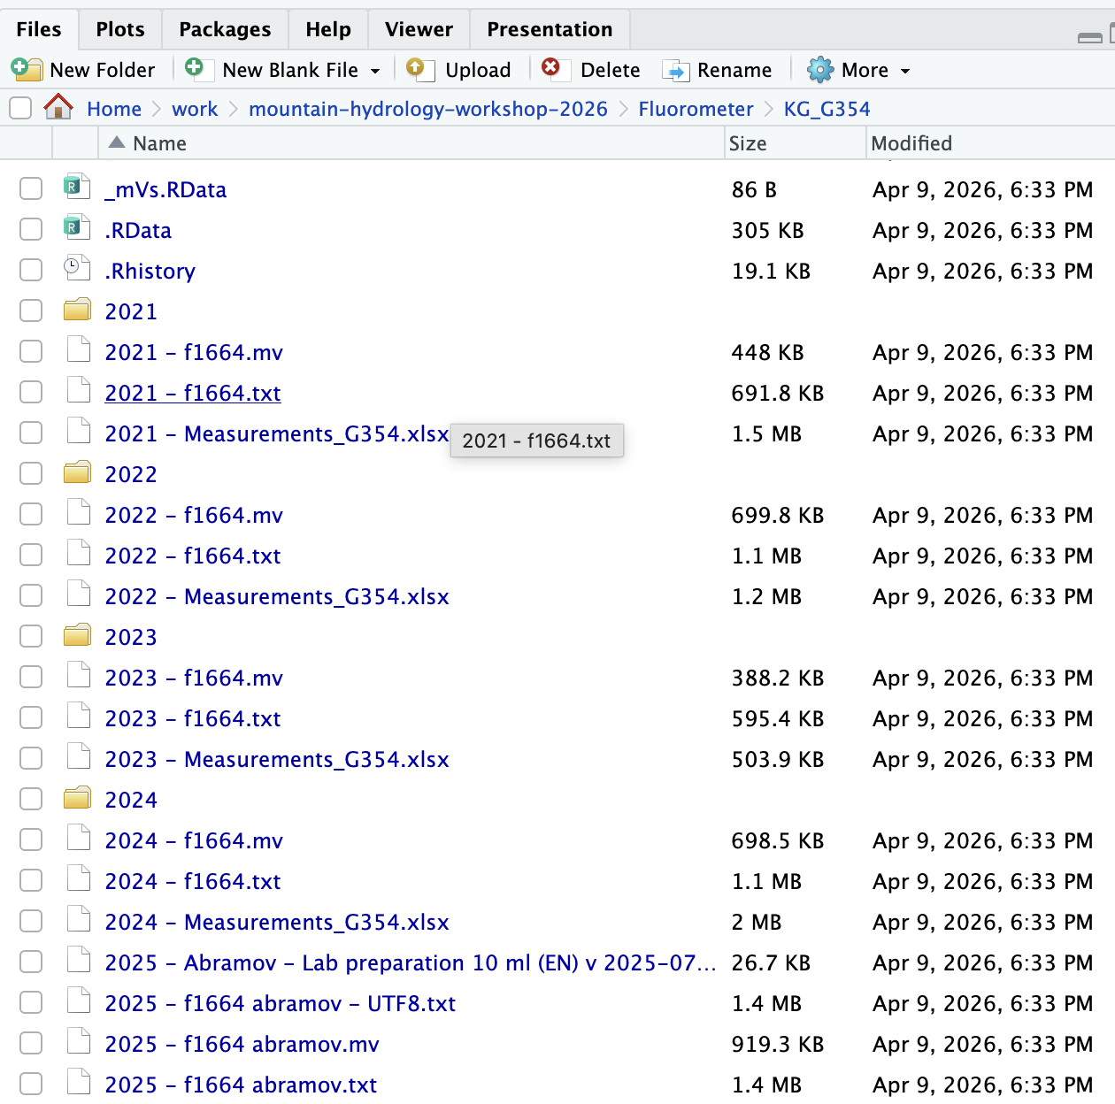
On the SD-card of the fluorometer are 3 files
cal.dat
Calibrat.dat
fXXXX.txt (XXXX is the serial number of the logger)
I call each year’s file according to the
Year, e.g. 2022
Logger number, e.g. f1664
“2022 - f1664.txt”
The files need to be converted …

Slide 3
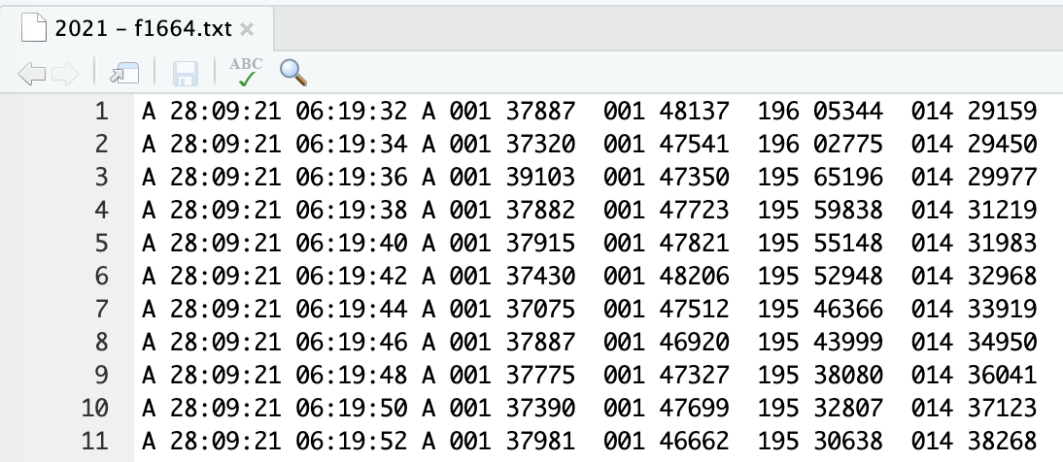
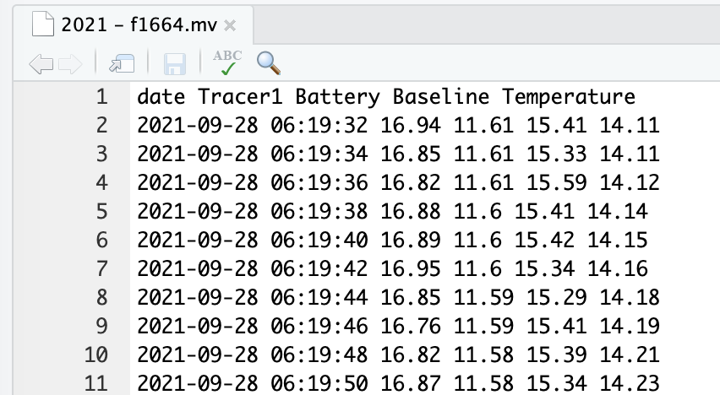
Before conversion
(binary format)
After conversion

Slide 4
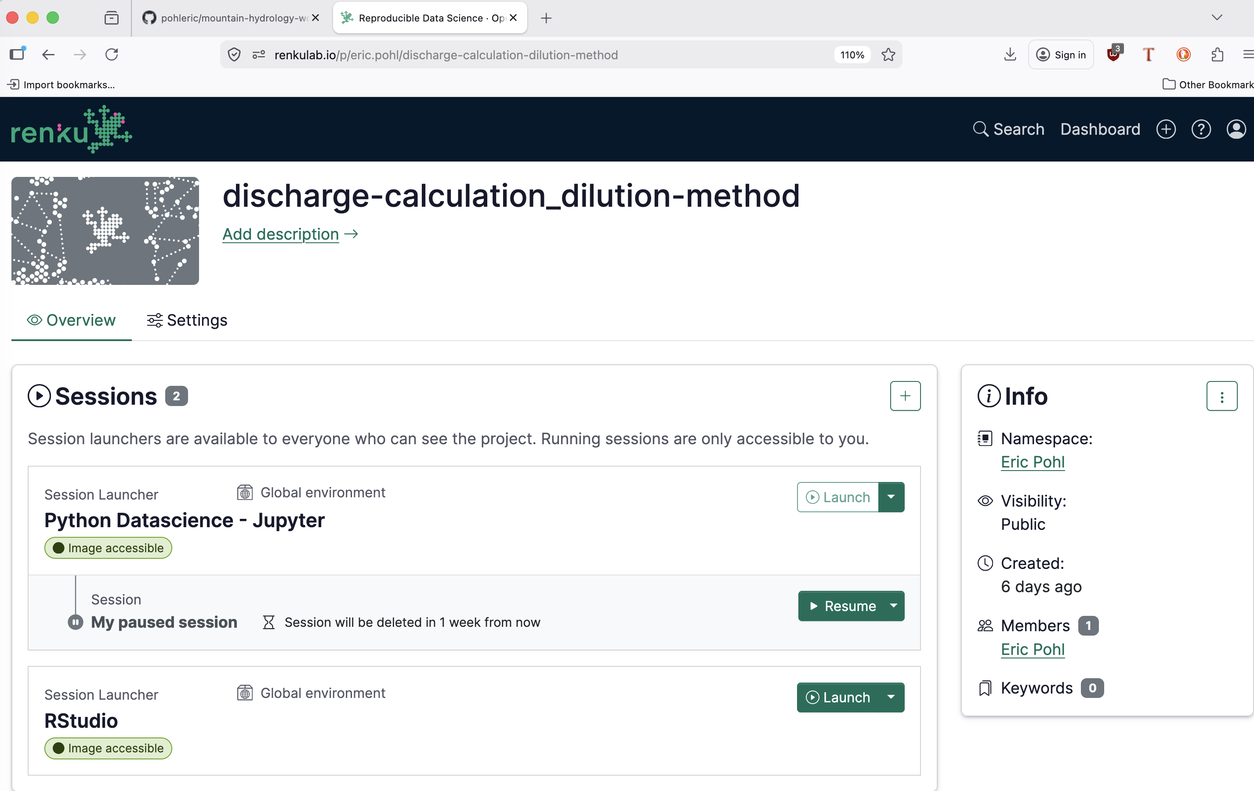
https://renkulab.io/p/eric.pohl/discharge-calculation-dilution-method
Takes around 2 minutes to open
click

Slide 5
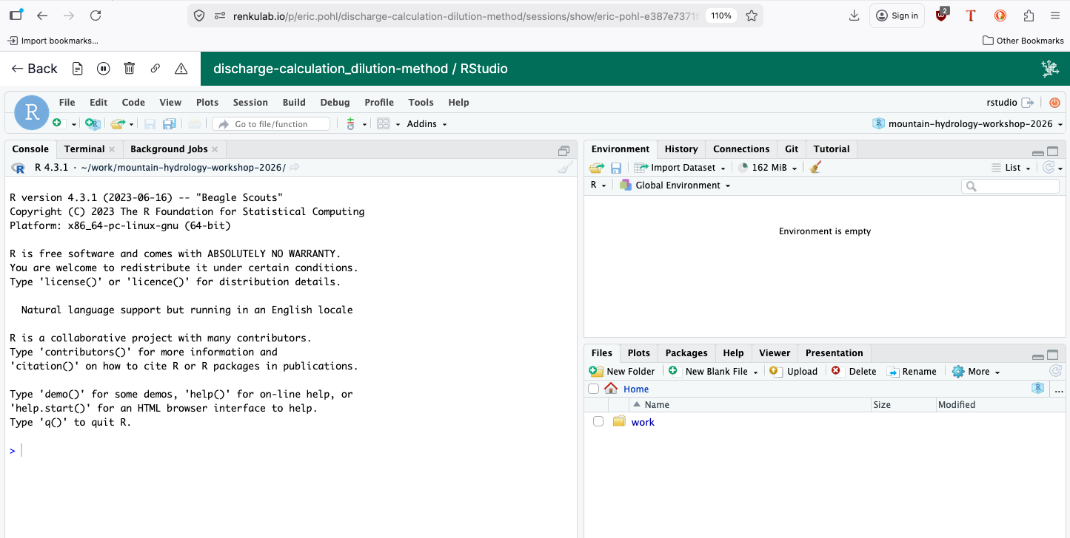
Opening the program. Directory: work/CA-hydroworkshop/materials/Fluorometer/KG_G354/R/003_Qcalc.R
click

Slide 6
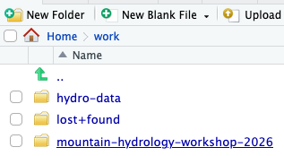
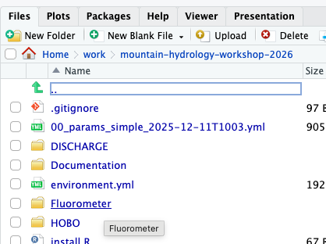
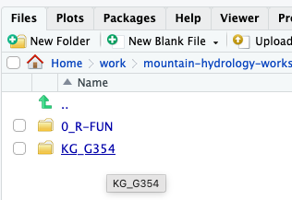
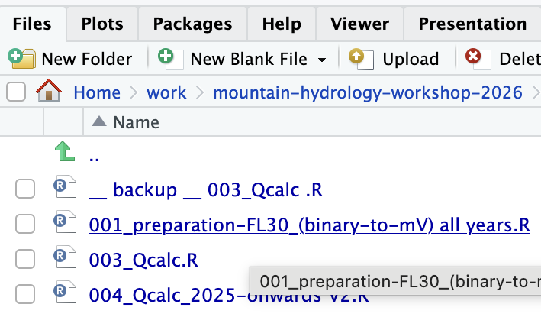

Opening the program. Directory: work/CA-hydroworkshop/materials/Fluorometer/KG_G354/R/001_prep….R
1
2
3
Click, click, click …
4
5

Slide 7
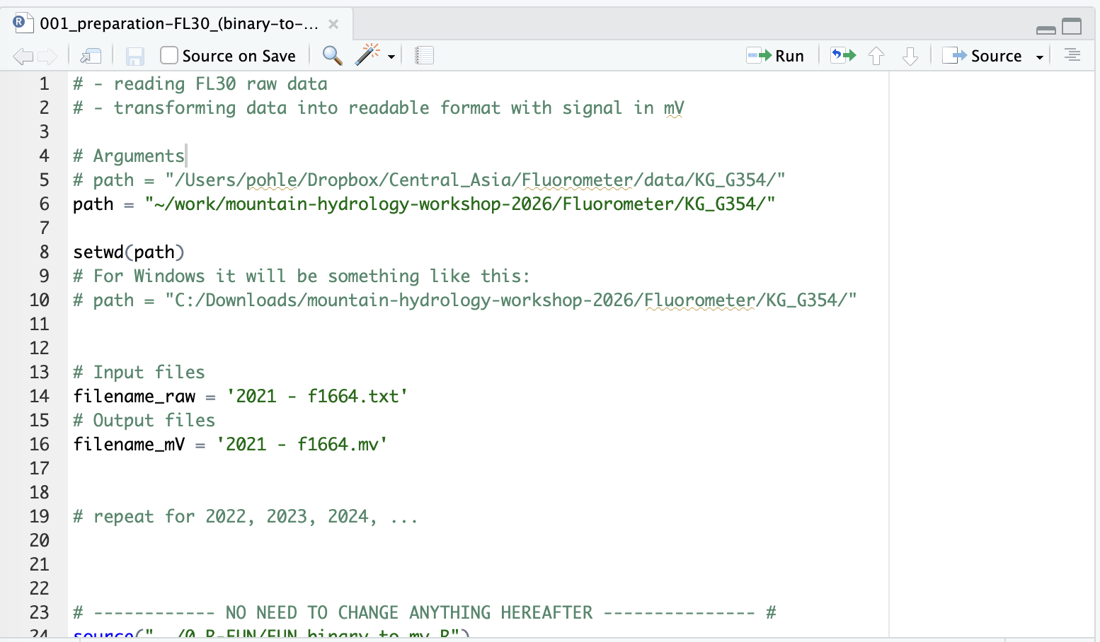
This is the conversion “script” (program)

Slide 8
This is the conversion “script” (program)
The program is designed that you only have to change very few things!
These things are:
Define the input name
Define the output name
That’s it. You don’t need to change anything else!

Slide 9
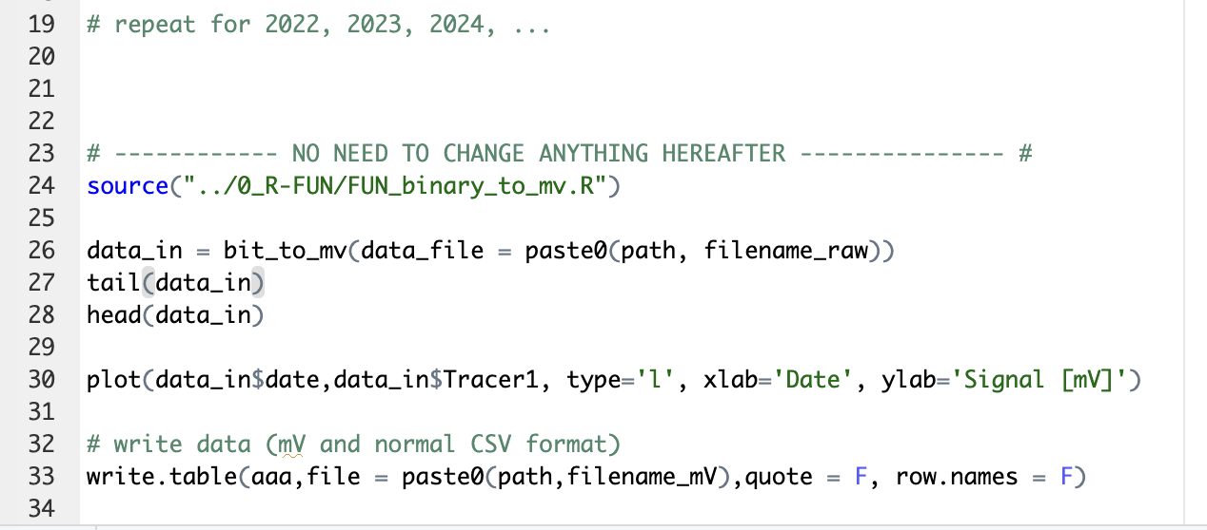
Scroll down to where it says:
“# ------------ NO NEED TO CHANGE ANYTHING HEREAFTER --------------- #
Click into this line
Run line by line [Ctrl]+[Enter]
You will see graphs produced
It will write the mV output file

Slide 10
Possible issues
Prepare the original input file:
Check the dates and remove all lines that are not from the measuring period
Some loggers have a wrong date (usually maximum a few days off)
Start from the last entry (check with your filed notebook when the last measurement was made)
Identify the date and time offset
Use that information to remove non-relevant data entries
Corrupt file from the FL30
→ Error when running the script/program
Solution:
Read error message
It will say where in the original file the error occurs
Remove the line
Try again
Switched interval (e.g. from 2 seconds to 30 seconds)
→ Error when running the script/program
Solution:
Cut out (delete) the part; this part will look different in the original file

